Slide 1
Data 101
Final Project
By: Andy Kim (ahk103)

Slide 2


I decided to do a combination of Hypothesis Testing and Data Visualization for my Final Project
For my final project, I decided to examine data of delayed domestic flights.
I have experienced the frustration with delayed flights as one of my plane trips in Summer 2019 was delayed, so this particular topic interests me.
I want to see if there’s a pattern between all these flights that were delayed so that maybe I could even predict if a future flight would more likely be delayed or not.

Slide 3
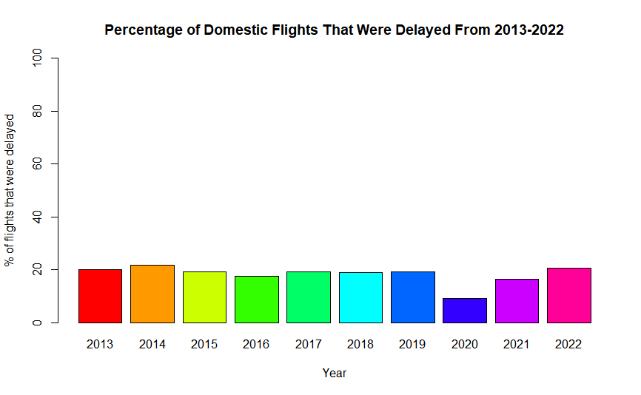
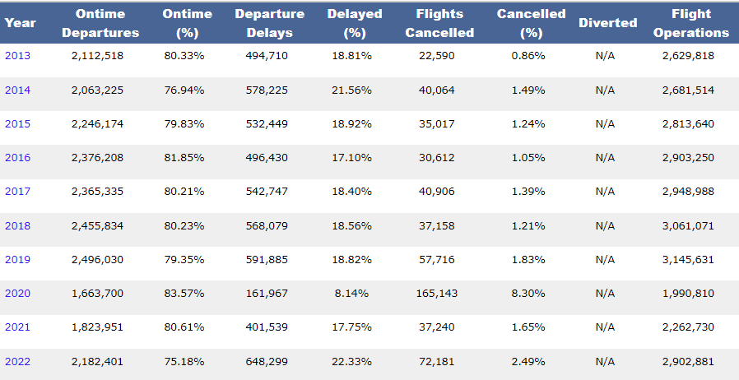
Data From The Federal Bureau
of Transportation Statistics
According to the Federal Bureau of of Transportation Statistics, from 2013-2022 for all Major Domestic Carriers from 1987-Present, the average of departures that were delayed is 18.04%, which is still very significant considering the yearly average number of domestic flight operations from 2013-2022 is 2,443,701.

Slide 4

How will I form my Conclusion?
I will be using 3 different datasets of flights from 2016, 2018, and the First Half of 2020 for two months(January & June).
I will test 3 hypotheses for departure delays in order to make my conclusion.
Through my hypotheses, I will test multiple variables to see if there’s a pattern with the number of delayed flights that month.

Slide 5
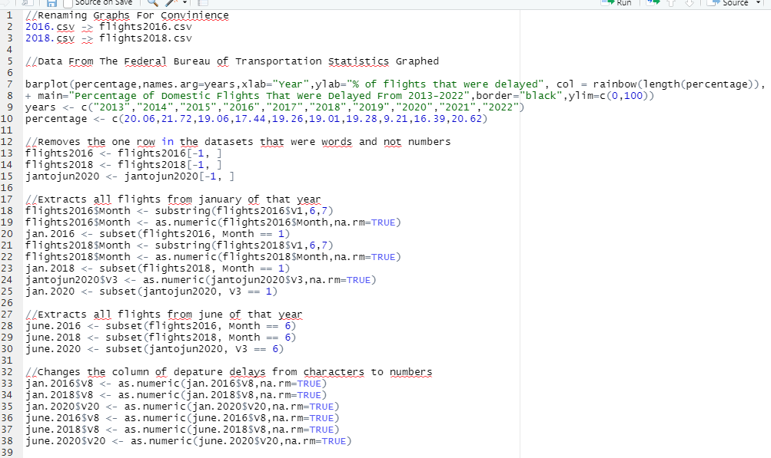
Code Set-Up For Graphs/Hypotheses

Slide 6
Hypothesis 1: Longer distance flights are likely to have more delays than shorter distance flights.
Null Hypothesis: Longer distance flights are likely to have a similar number departure delays as shorter distance flights.
 | Long 2016 | Short 2016 | Long 2018 | Short 2018 | Long 2020 | Short 2020
Mean | 9.05521 | 6.909053 | 9.009614 | 9.804817 | 6.480414 | 6.276121
Standard Deviation | 37.51423 | 36.32178 | 44.33105 | 47.56852 | 40.92977 | 45.49496
Length | 183538 | 262289 | 225462 | 344656 | 255657 | 404899
 | 2016 | 2018 | 2020
Z-Score | 19.0459 | -6.43266 | 1.891547
P-Value | 0 | 1 | 0.02927569
We can reject the null hypothesis for the 2016 and 2020 flight datasets but not the 2018 flight dataset. Therefore, this hypothesis and factor is only somewhat significant.

Slide 7
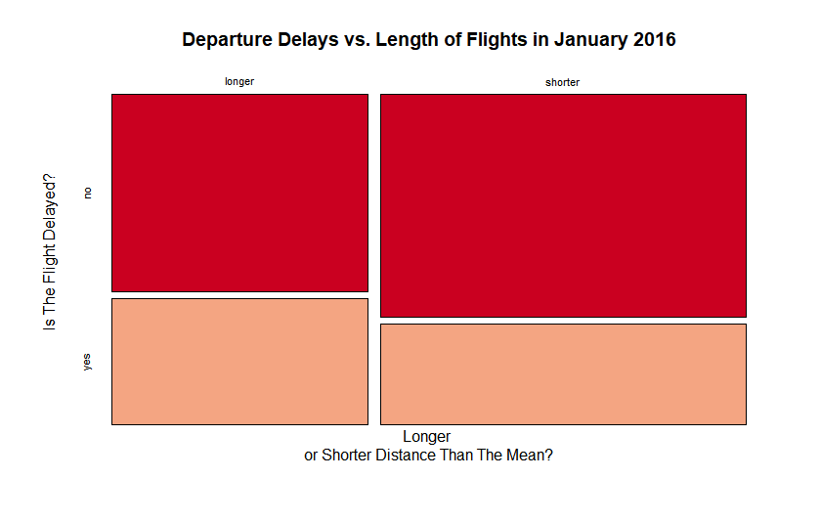
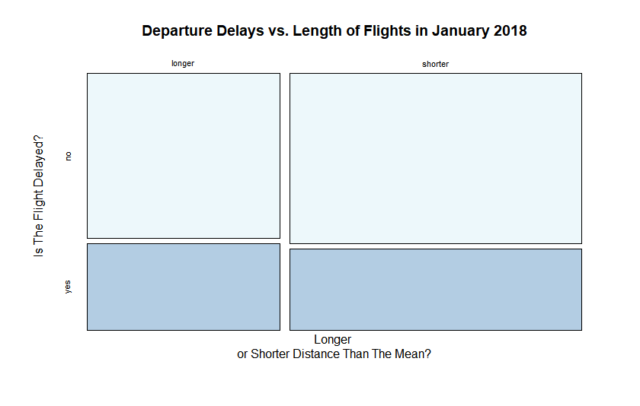
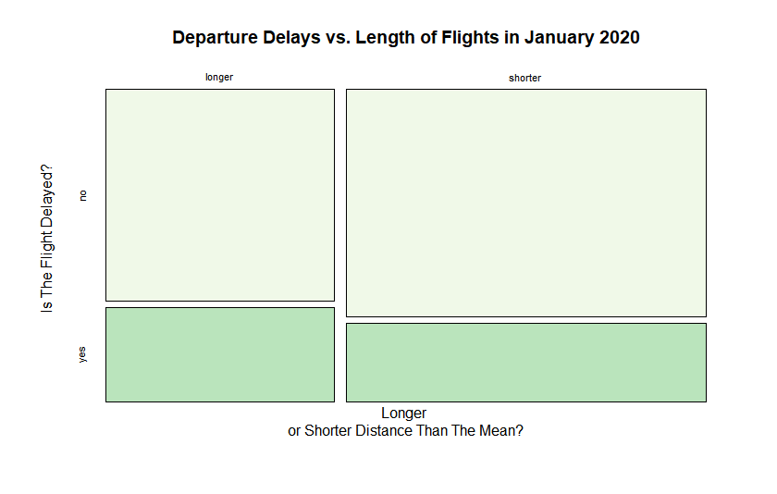
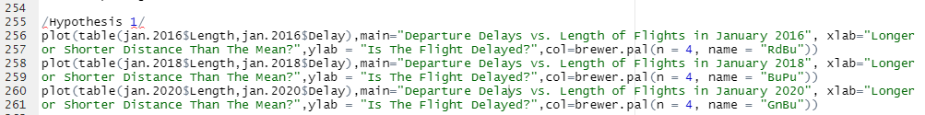
To put things into perspective…
In the graphs, there’s a somewhat significant difference in the number of flight delays in January 2016 and January 2020, but barely any difference can be seen in January 2018, which supports the z-scores/p-values that were calculated.

Slide 8
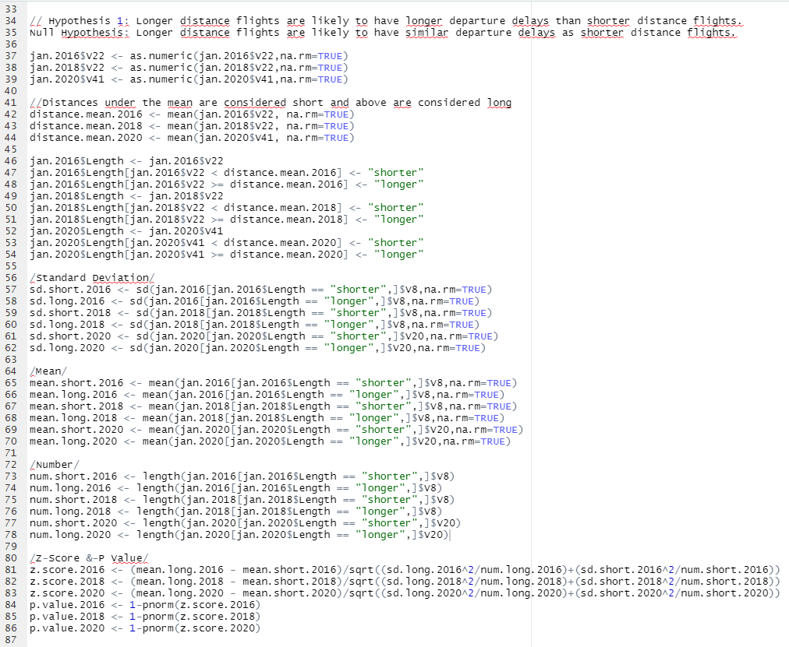
Hypothesis 1 Code

Slide 9
Hypothesis 2: Weekend flights are likely to have more departure delays than Weekday flights.
Null Hypothesis: Weekend flights are just as likely to have departure delays as Weekday flights.
 | Weekends 2016 | Weekdays 2016 | Weekends 2018 | Weekdays 2018 | Weekends 2020 | Weekdays 2020
Mean | 8.843282 | 7.36338 | 7.107702 | 10.22312 | 9.566213 | 5.364627
Standard Deviation | 40.17187 | 35.36499 | 42.4329 | 47.41572 | 51.11796 | 41.1991
Length | 132308 | 313519 | 437809 | 132309 | 156692 | 503864
 | 2016 | 2018 | 2020
Z-Score | 11.63212 | -22.75548 | 29.67631
P-Value | 0 | 1 | 0
We can reject the null hypothesis for the 2016 and 2020 flight datasets but not the 2018 flight dataset. Therefore, this hypothesis and factor is only somewhat significant.

Slide 10
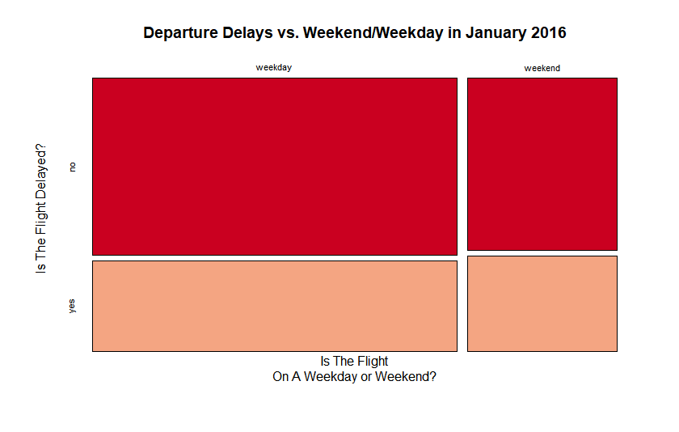
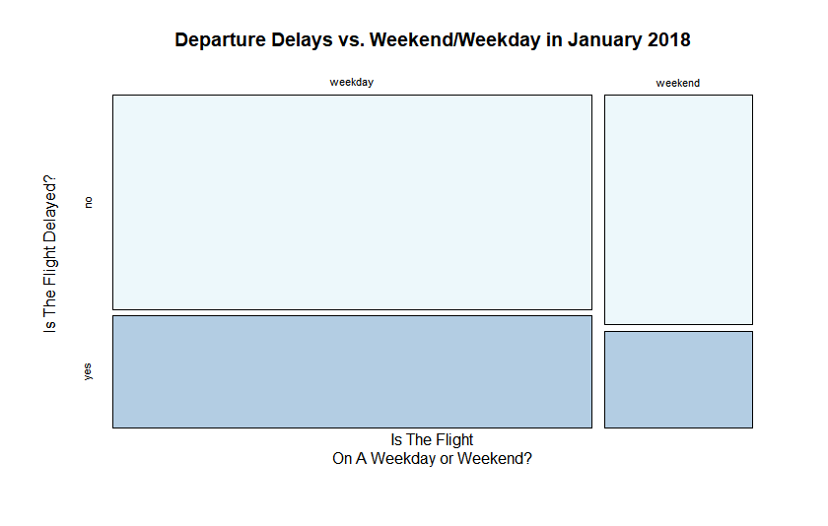
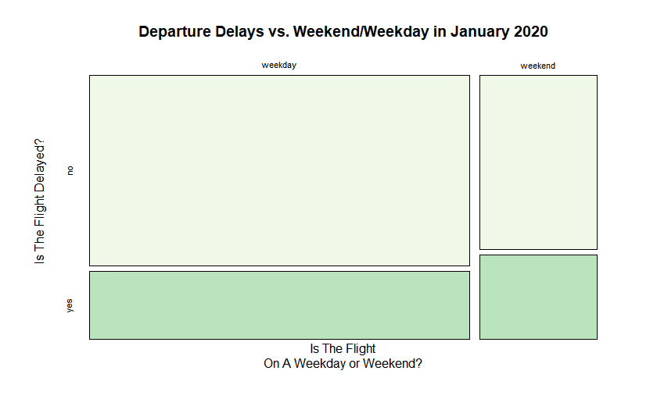
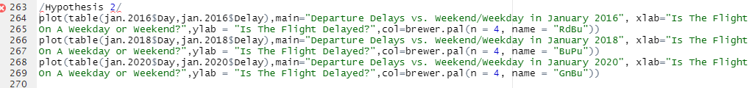
To put things into perspective…
There are more delays on the weekends than weekdays in the January 2016 and 2020 graphs but there are more delays on the weekdays than weekends in the January 2018 graph, which supports the z-scores/p-values that were calculated.

Slide 11
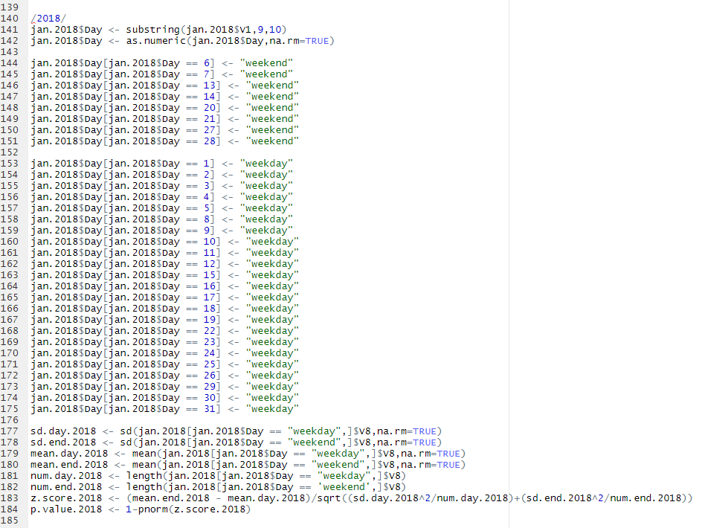
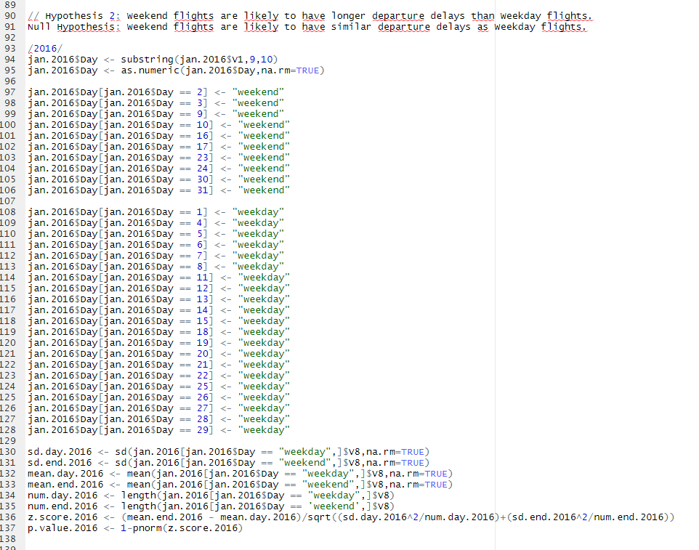
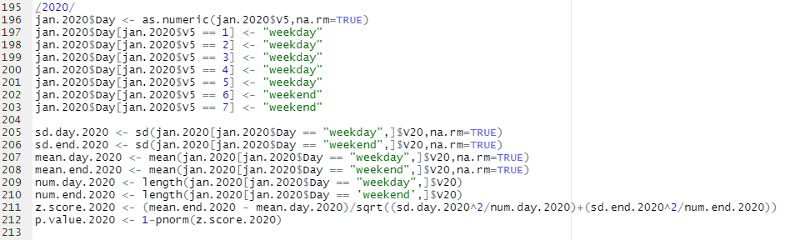
Hypothesis 2 Code

Slide 12
Hypothesis 3: Flights in the summer are more likely to have departure delays than flights in the winter.
Null Hypothesis: Flights in the summer are just as likely to have departure delays as flights in the winter.
 | January 2016 | June 2016 | January 2018 | June 2018 | January 2020 | June 2020
Mean | 7.793537 | 11.69959 | 9.487917 | 13.05595 | 6.355502 | -0.3461768
Standard Deviation | 36.83301 | 42.99643 | 46.30707 | 49.12101 | 43.77776 | 26.56202
Length | 445827 | 487637 | 570118 | 626193 | 660556 | 237264
We can reject the null hypothesis for the 2016 and 2018 flight datasets but not the 2020 flight dataset. Therefore, this hypothesis and factor is somewhat significant.
 | 2016 | 2018 | 2020
Z-Score | 47.24929 | 40.88924 | -87.43399
P-Value | 0 | 0 | 1

Slide 13
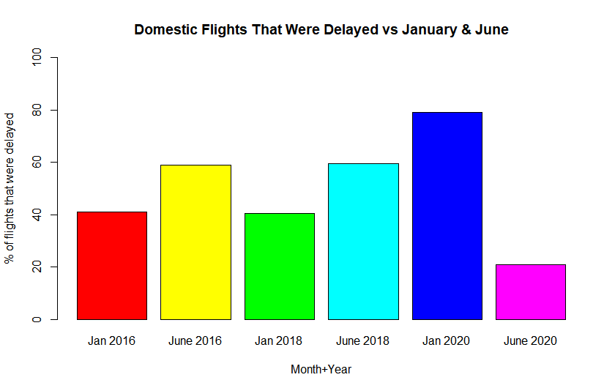
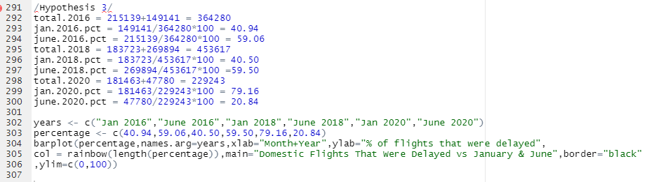
To put things into perspective…
For 2016 and 2018, of all the flights that were delayed in January and June, June had the higher percentage of those delayed flights. On the other hand, of all the flights that were delayed in January and June in 2020, January actually had the higher percentage of the delayed flights. This is probably because of the COVID pandemic reducing the number of flights.
This chart ultimately supports the z-scores/p-values that were calculated.
Hypothesis 3 Chart Code:

Slide 14
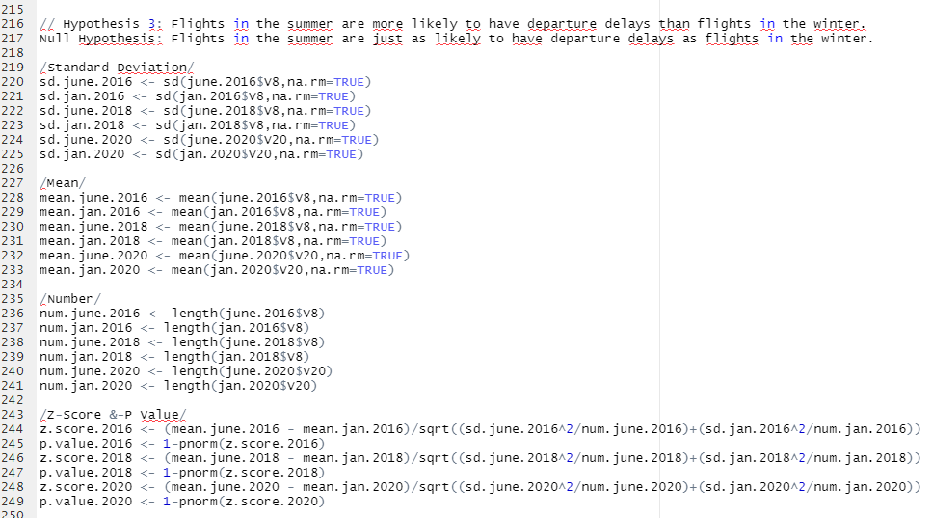
Hypothesis 3 Code

Slide 15


Final Conclusion
Through my research with these three datasets, there seems to be a general pattern with the three variables I tested: Short vs Long Flight Distance, Weekday vs Weekend, and Winter vs Summer.
The trend is that longer flights, weekend flights, and summer flights are generally more likely to be delayed than shorter flights, weekday flights, and winter flights.
With this general information, perhaps in the future when I have take a flight somewhere, I can use this information to somewhat predict if the flight would likely be delayed or not and be prepared for it.

Slide 16
Datasets’ Source
Federal Bureau of Transportation Statistics: https://www.transtats.bts.gov/homedrillchart.asp
2008-2018 Dataset: https://www.kaggle.com/datasets/yuanyuwendymu/airline-delay-and-cancellation-data-2009-2018
Jan-Jun2020 Dataset: https://www.kaggle.com/datasets/akulbahl/covid19-airline-flight-delays-and-cancellations?select=jantojun2020.csv

